Slide 1




Smile Eyes x STAAR Surgical
Partnering for Research Excellence
Presented by:
Dr. Martin Bechmann
Dr. Martin Heese
Aziza Guellouz, M.Sc
31.01.2025

Slide 2



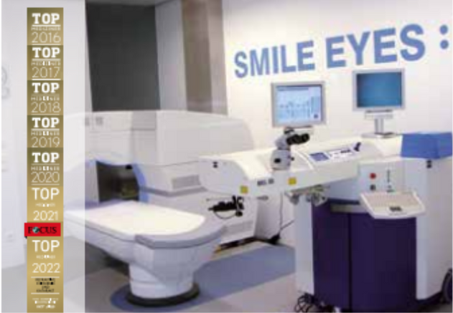
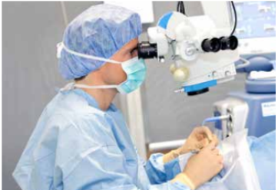
Smile Eyes at a Glance
A Leader in Refractive Surgery in Germany and Austria
20+ years
of expertise in refractive surgery.
  Comprehensive eye care expertise
  Full range of refractive procedures:
    Laser-based: SMILE, Femto-LASIK, LASEK/PRK/Trans-PRK
    Lens-based: ICL, CLE, Multifocal lenses
  Eye health is at the heart of our work
20+ locations
in Germany and Austria
30,000+ operated
refractive procedures
150+ Research Projects
15 Years of Experience with EVO ICL
1,500+ EVO ICL Procedures in 2023

Slide 3

What We Deliver
High-quality medical publications
Peer-reviewed studies evaluating the safety, efficacy, and long-term performance of EVO ICL.
Comparative analyses comparing EVO ICL with other refractive solutions
Case studies documenting real-world outcomes and patient satisfaction.
Contributions to leading ophthalmology conferences through publications and presentations.

Slide 4






Our Approach to Driving Impactful Research
Leveraging expertise, collaboration, and data for meaningful outcomes
Access to a diverse patient database and cutting-edge infrastructure.
Foster Interdisciplinary Collaboration
Leadership in EVO ICL implementation and proven patient outcomes.
Leverage Clinic Resources
Utilize state-of-the-art facilities and advanced technology for precise data collection.
Combine expertise from clinicians, researchers, and Smile Eyes teams to develop innovative studies.
Access to a diverse patient database and comprehensive case history.
Our Approach to Driving Impactful Research
Expertise from 150+ research projects and a track record of impactful results.
Utilize Patient Data
Engage Expert Doctors
Analyze real-world outcomes ethically and systematically to create impactful studies.
Collaborate with experienced surgeons for clinical insights and research contributions.

Slide 5







Shaping the Future of Vision Together
Global Credibility: Peer-reviewed studies enhance EVO ICL’s reputation worldwide.
Delivering premium quality to our patients
Driving innovation in refractive surgery.
Informed Decisions: Comparative data supports objective clinical choices.
Patient Trust: Real-world outcomes build confidence and demand.
Shared Commitment
Market Growth: Scientific contributions drive adoption in new regions.
Partner with us to make EVO ICL the first choice for doctors and patients globally.

